Slide 1
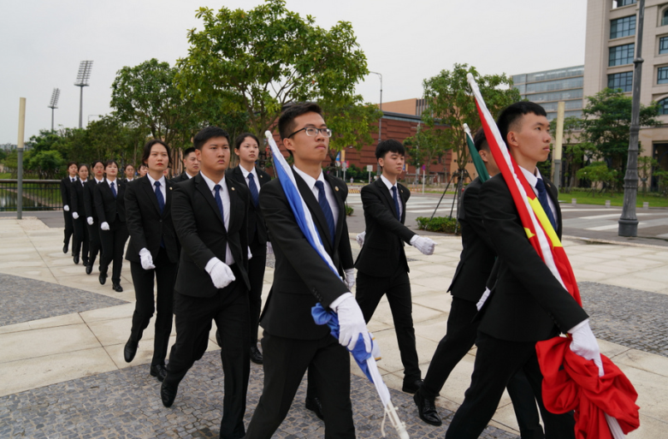
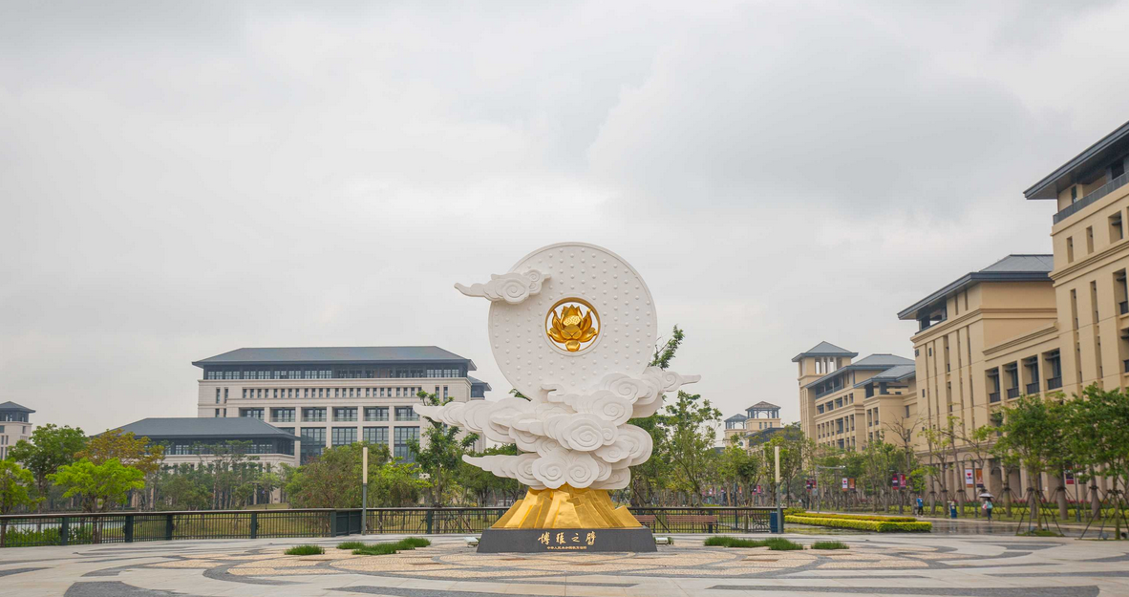
Honorary Degree Day Flag Raising Ceremony
澳大榮譽學位頒授日升旗典禮
Date: 9 Nov. 2019 (Saturday) @8am
Meet at 7:45 am in front of CKPC
Venue: Lotus Plaza (in front of N6)
Dress code: CKPC T-shirt
Support fellow CKPC Students in National Flag Team
Counted as one RC activity 算一次書院活動！

